Slide 1
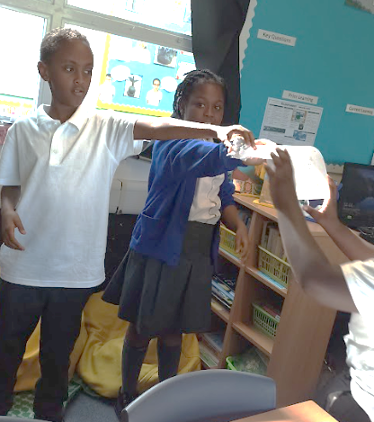



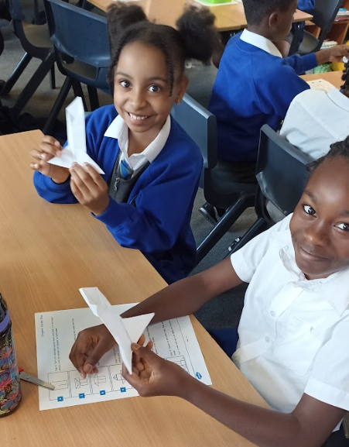
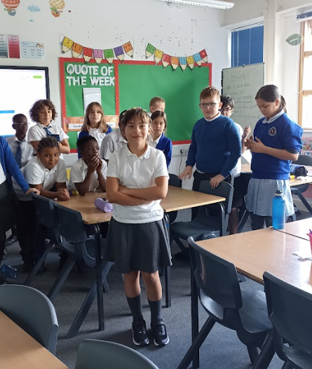
Welcome to
Meet the Teacher
Curriculum Meeting

Slide 2
Agenda
Meet the team
3 Vs: Vision, Value and Virtues - What we believe
Expectations
Behaviour
Out line of the Curriculum-What your child will learn
Reading Record & Homework
How you can help us
SEND
Rights Respecting School
Coffee Morning
Sign posting-School website
Questions, questions, questions????

Slide 3

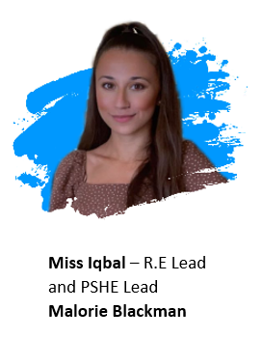
Year 5 Team
Miss Fairweather – Learning Support Staff
Ms Maryam – Learning Support Assistant

Slide 4
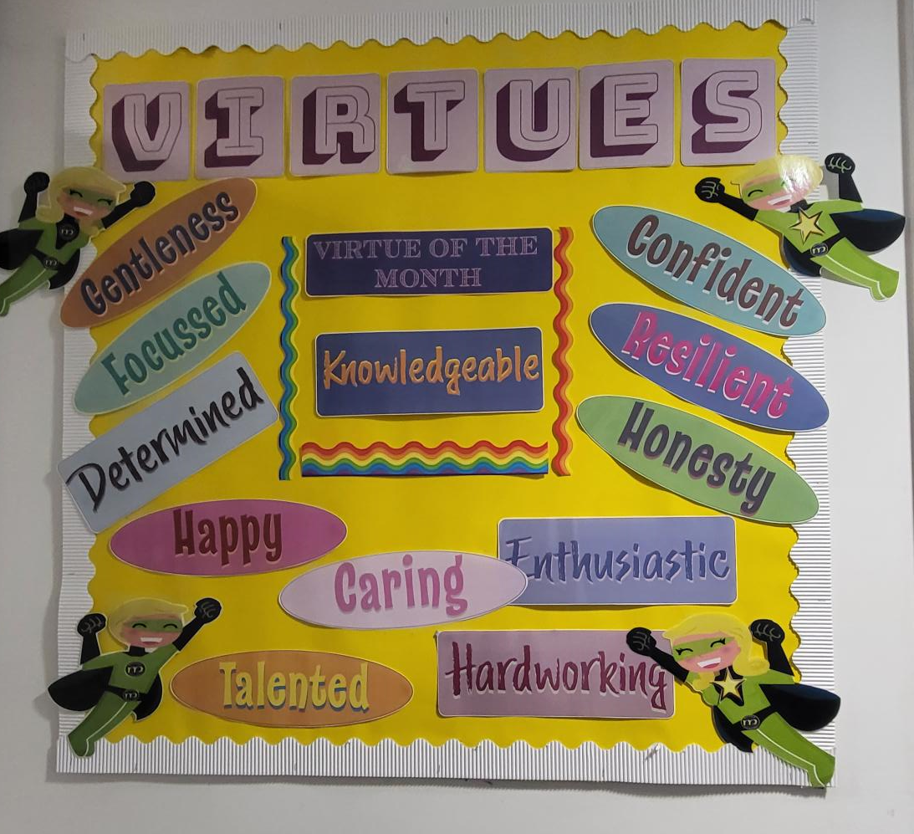
School Vision and Values
Values
To have a joy for learning
Being the heart of our community
Raising aspirations
Creating lasting memories
Celebrating uniqueness
Unity through inclusion and diversity
Shaping futures together
T.E.A.M- Together everyone achieves more

Slide 5
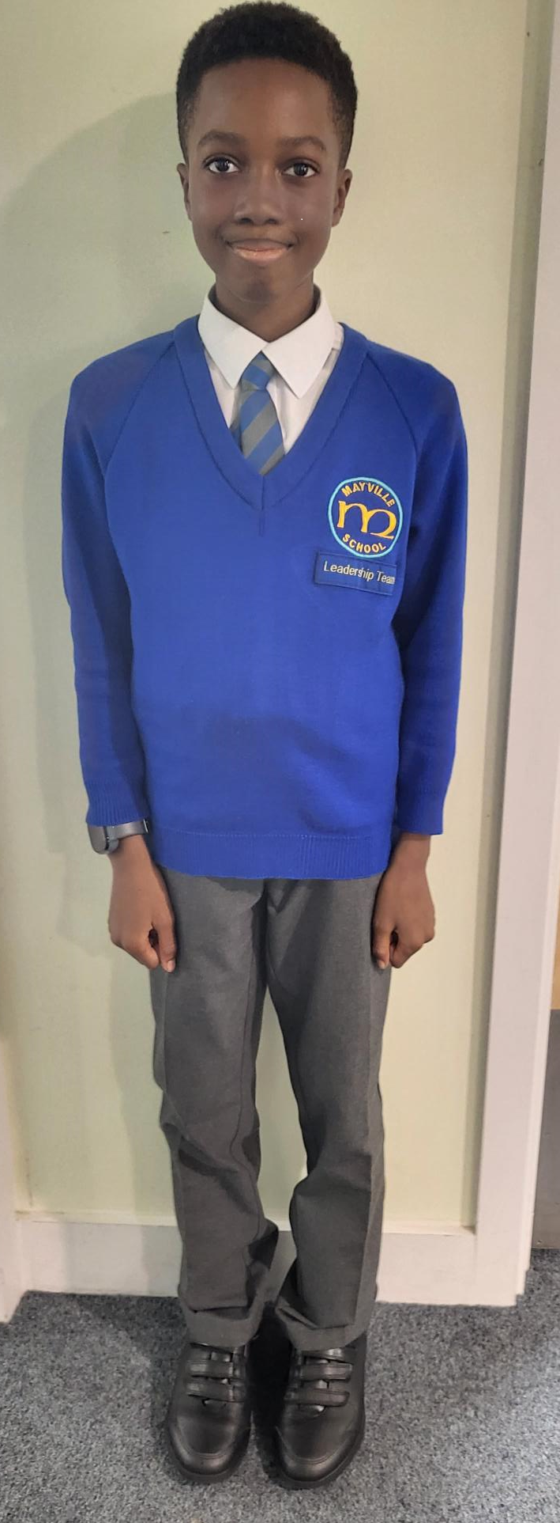
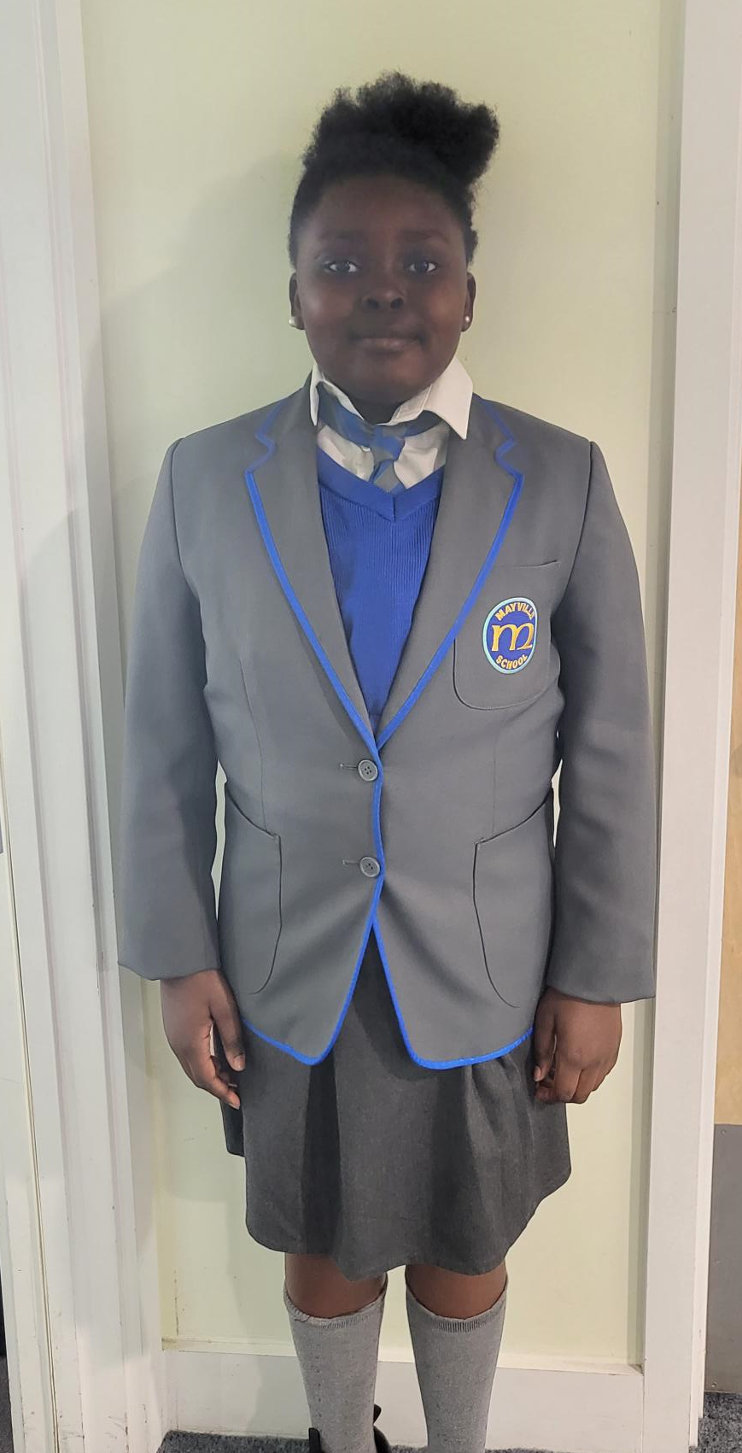
Expectations
School Uniform | PE Uniform
Grey Trousers or Shorts | White T-shirt
Grey Skirt or Pinafore | Black Shorts / leggings
Blue and white gingham checked dress (Summer) | White/Black Plimsolls for indoor PE
White Polo Shirt | Trainers for outdoor PE
Blue Sweatshirt or fleece with logo | Black tracksuit trousers for outside during cold weather
Black School Shoes (high heels are not permitted)

Slide 6

Attendance & Punctuality
Punctuality and attendance is monitored by the local authority and this is an area where we need to improve
In order for the children to learn, develop and maintain friendships they need to be in school every day.
The government says that children’s attendance needs to be no less than 96%.
Anything below 95% is poor attendance and if it is 90% or less it is termed as a persistent absence.
We work closely with Waltham Forest councils attendance officer who comes into school regularly - Heather.
Please do let class teachers know if we can help in any way to improve punctuality and attendance for your child

Slide 7

Behaviour
Gold | Exceptional behaviour Significant achievement | Gold award Gold Sticker
Silver | Consistent politeness Selfless behaviour | Silver sticker
Bronze | Better than expected behaviour Kind/caring/ volunteering to help around | Bronze sticker
Green | All children start each day on GREEN Expected behaviour – Class rules
Blue | Low level disruption i.e. talking, not listening, calling out, running, carelessly pushing others, arguing with peers, littering | Child is moved down to blue In class timeout warning
Yellow | Persistent blue behaviour Being uncooperative Deliberately ignoring adult Unkind / rude | Child is given reflection sheet and sent to buddy class for 5-10 mins depending on age Logged on CPOMS 3x reflection sheet call home
Red | Racism Bullying Serious lying Violence Biting Stealing | Lunchtime with DT or HT Logged on CPOMS Call made home
At Mayville we focus on a positive reinforcement approach for all learners which is achieved using the following strategies:
Use of positive praise throughout lessons
Celebration of good work using certificates, stickers, stars and messages home
Positive comments and peer praise

Slide 8
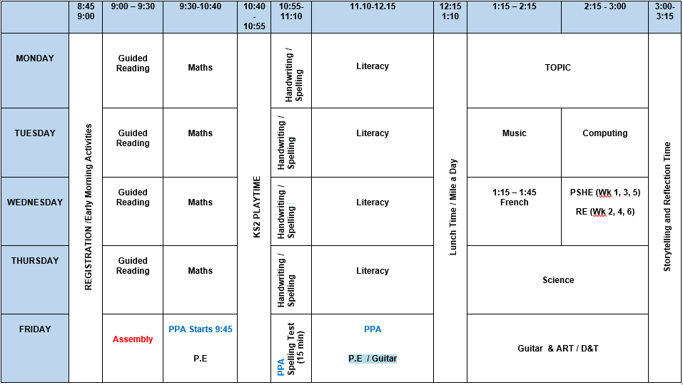
Year 5 Structure of the Day
Start time:
8:50
Finish time:
3:20
PE
Every Fridays

Slide 9


Slide 10
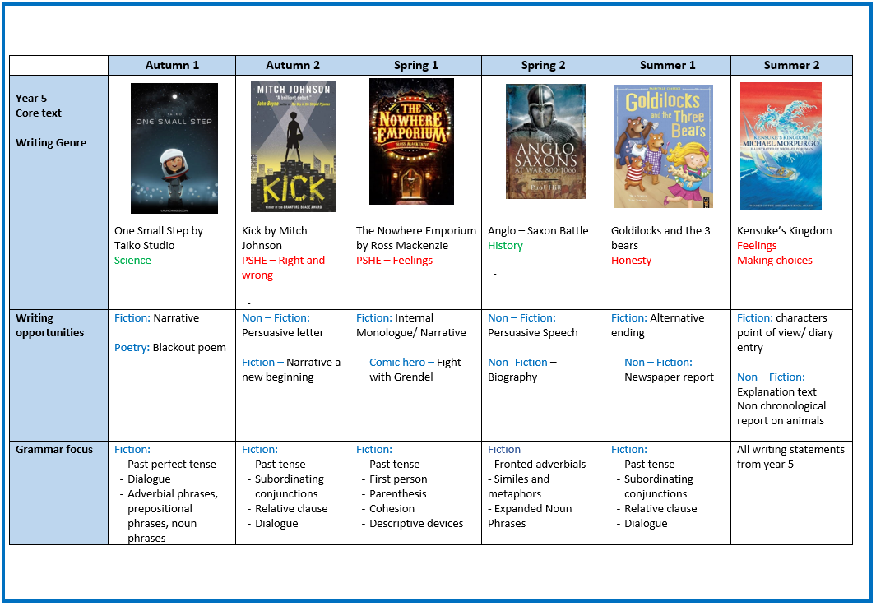

Slide 11
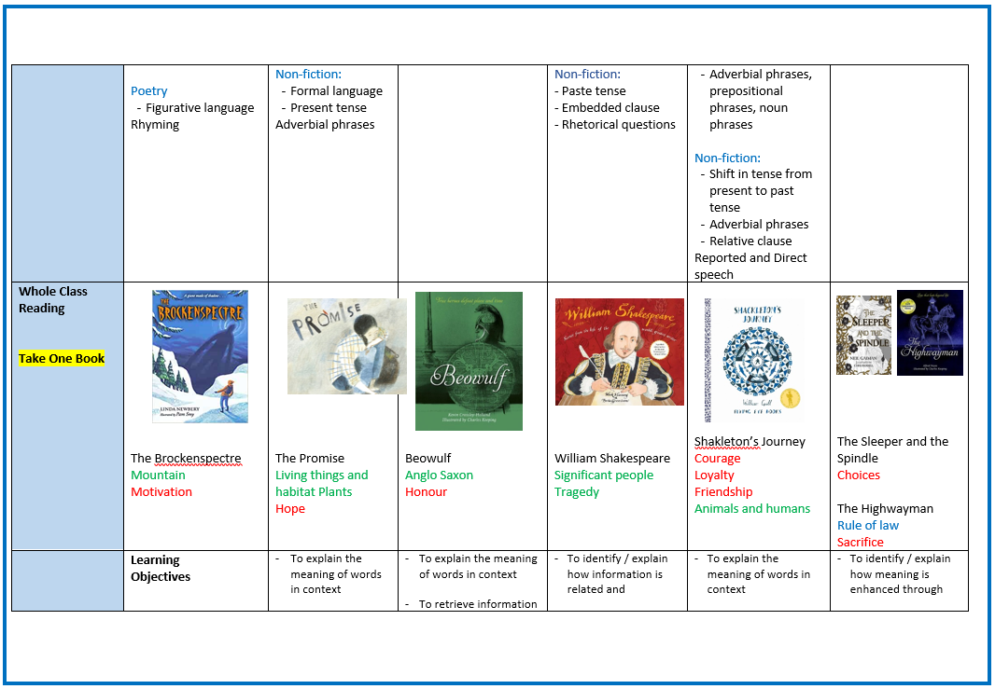

Slide 12
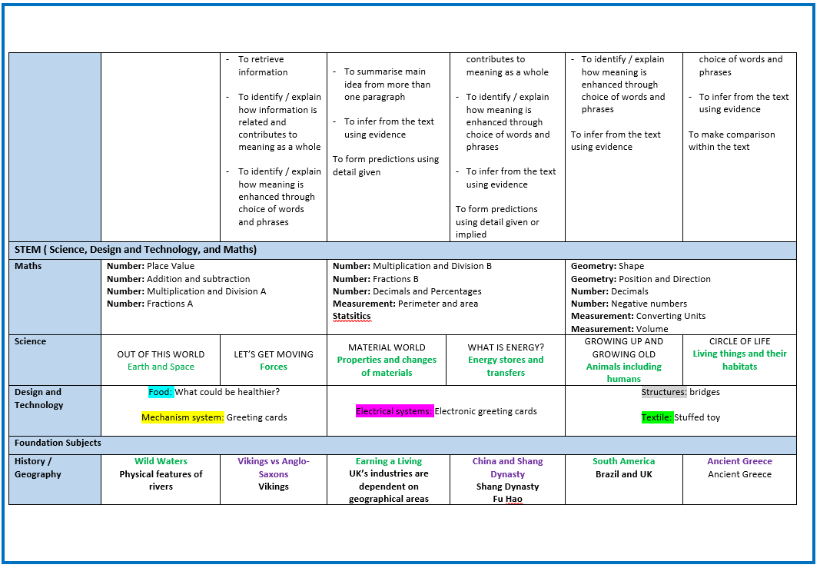

Slide 13
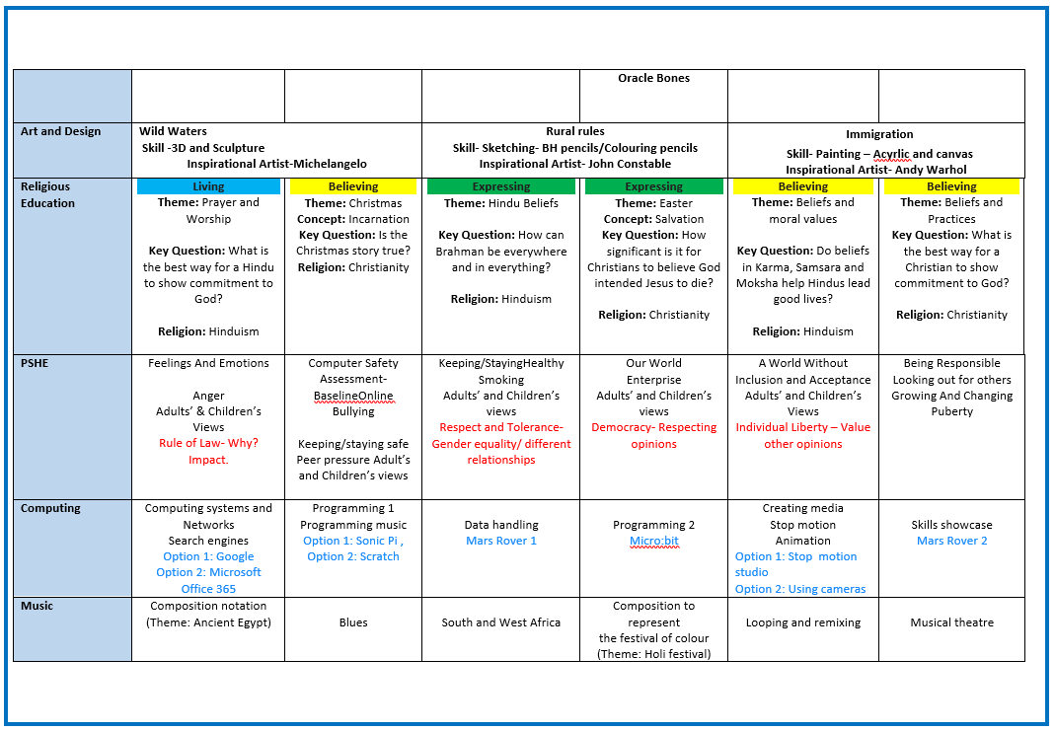

Slide 14
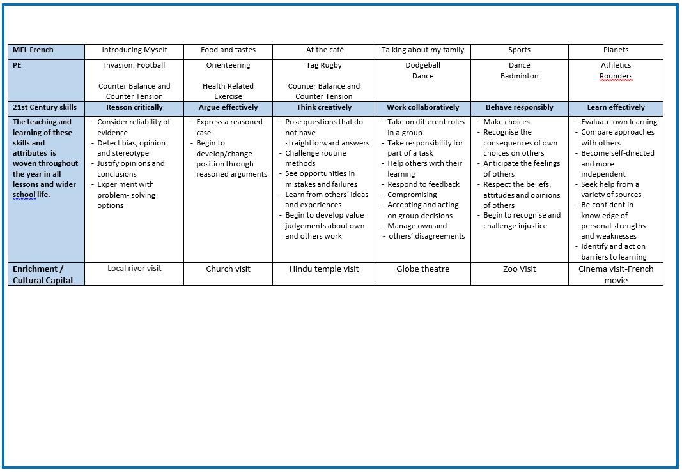

Slide 15
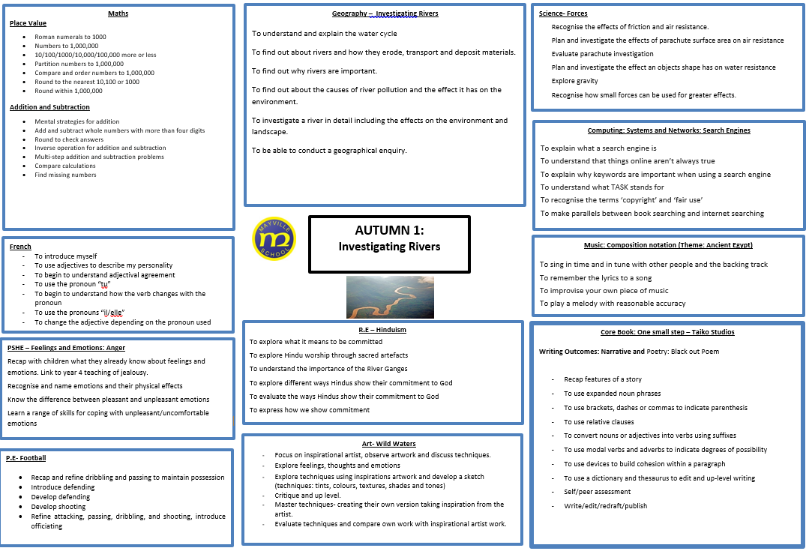
Year 6 Structure of the Day

Slide 16



Homework will be set every Fridays on Atom Prime Learning
Homework due by Wednesday the latest.
Children are given instant feedback and questions are adapted according to their understanding.
Children will receive the following:
English – (Some sort of Spelling/ Grammar / Punctuation and Reading comprehension)
Maths – consolidate learning across the week
Foundation subjects (a range across the term) via hard copy or Google Class

Slide 17

Reading Record
All children have a Reading Record log to develop their passion and enjoyment for reading and literacy skills
Children in Year 5 are expected to record at least five entries per week (Monday-Sunday).
Parents are welcome to communicate about reading in the diaries.
Children are expected to read daily – encouraging your child to read daily will make a huge difference to their learning and progress. Studies have also shown that reading helps with social skills, behaviour and emotional development.
Three factors have been identified as very important to children’s reading – book choice, teacher encouragement and parental encouragement
Reading diaries should all be brought in on Friday with their school reading book.

Slide 18
How to support your child at home
Encouraging a positive attitude towards school and education
Use real life, everyday experiences to help learning - shopping and dealing with money, library trips, cooking at home
Develop areas they find challenging through play activities rather than workbooks and extra work…discovery is an exciting learning tool.
Encourage and take interest in homework – any assistance is allowed if you feel your child needs some help
Playing any fun word or number games, while on journeys or as children are going to bed
Explore real life experiences – museum trips (many are free), visits to places, explore the local area
Talk to your child about what they have learnt at school – can they teach you something new. ☺
Share – Maths booklet, Statutory Spelling, GR questions

Slide 19
School/Home Communication
In Year 5, sending a note in with your child may often be the best way to advise teachers of any issues, or also feel free to send an e-mail via the office.
Alternatively, you can see class teachers in the playground at the end of each day, or ask the office to make an appointment for a longer meeting, or we are happy to call you back to save a journey in to school if convenient.
Year 5 updates will be communicated via Google Class or letter sent home

Slide 20
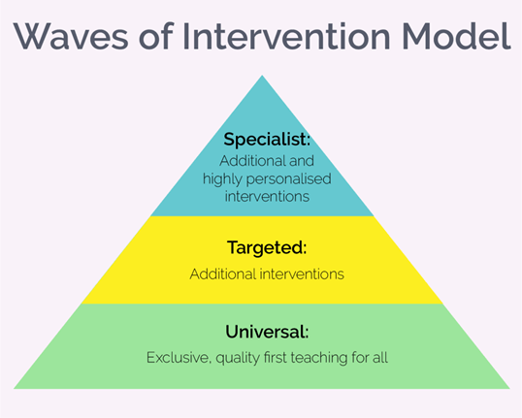
Special Educational Needs
What are Mayville's policies for the identification and assessment of pupils with special educational needs/disabilities (SEN/D)?
We assess each pupil’s skills and levels of attainment when they first come to the school. This builds on the information from the child’s previous early years or school where appropriate, and provides us with information we need to monitor their progress. It also ensures that we discover any areas of difficulty early on. Where children already have their SEND diagnosed or identified we will work closely with the family and our partners to make sure we know as much as possible about the child before they start with us.
Teachers work with the Senior Leadership Team to regularly assess pupils’ progress. This helps us to see any pupils whose progress is:
significantly slower than that of their peers starting from the same baseline
fails to match or better their previous rate of progress
fails to close the attainment gap between them and their peers.
Where assessments show that a child is not making adequate progress, our first response is to make sure there is high quality teaching in place. Making high quality teaching normally available to the whole class is likely to mean that fewer pupils will require additional support.
If their progress continues to be slower than expected after a period of monitoring and assessing, the teacher will speak with the school’s SENDCo, Nora Aalit, to carry out a clear analysis of the child’s needs, and identify if they need additional support that may involve external agencies.

Slide 21

Rights Respecting School
What is a Rights Respecting School?
The term ‘Rights Respecting School’ is given to schools that put the work of UNICEF at the heart of their educational policies and practices. Every child has rights and along with those rights come responsibilities. The adults and children in our school model these rights and respect them in all relationships. We aim to make children aware of their rights and to be respectful of the rights of adults and other children.
Why do we want to be a Rights Respecting School?
The ‘Rights Respecting School’ award (RRSA) helps our pupils to grow into confident, caring and responsible young citizens both in school and within the wider community. By learning about their rights, our pupils also learn about the importance of respecting the rights of others.
If any parents or carers would like to continue to support us in embedding children’s rights within our school community, please speak to Mrs Griffin or the school office to find out how you can become involved.
If you would like to find out more about the work of UNICEF or the Rights Respecting School Award, please
follow the link below: http://www.unicef.org.uk/

Slide 22

Coffee Mornings
Coffee Morning sessions take place in school hall on a regular basis.
The sessions cover a variety of topics and aim to help you support your child with learning at home.
All of the coffee morning dates are available to view on the website calendar and are also included in the school’s fortnightly newsletters.

Slide 23
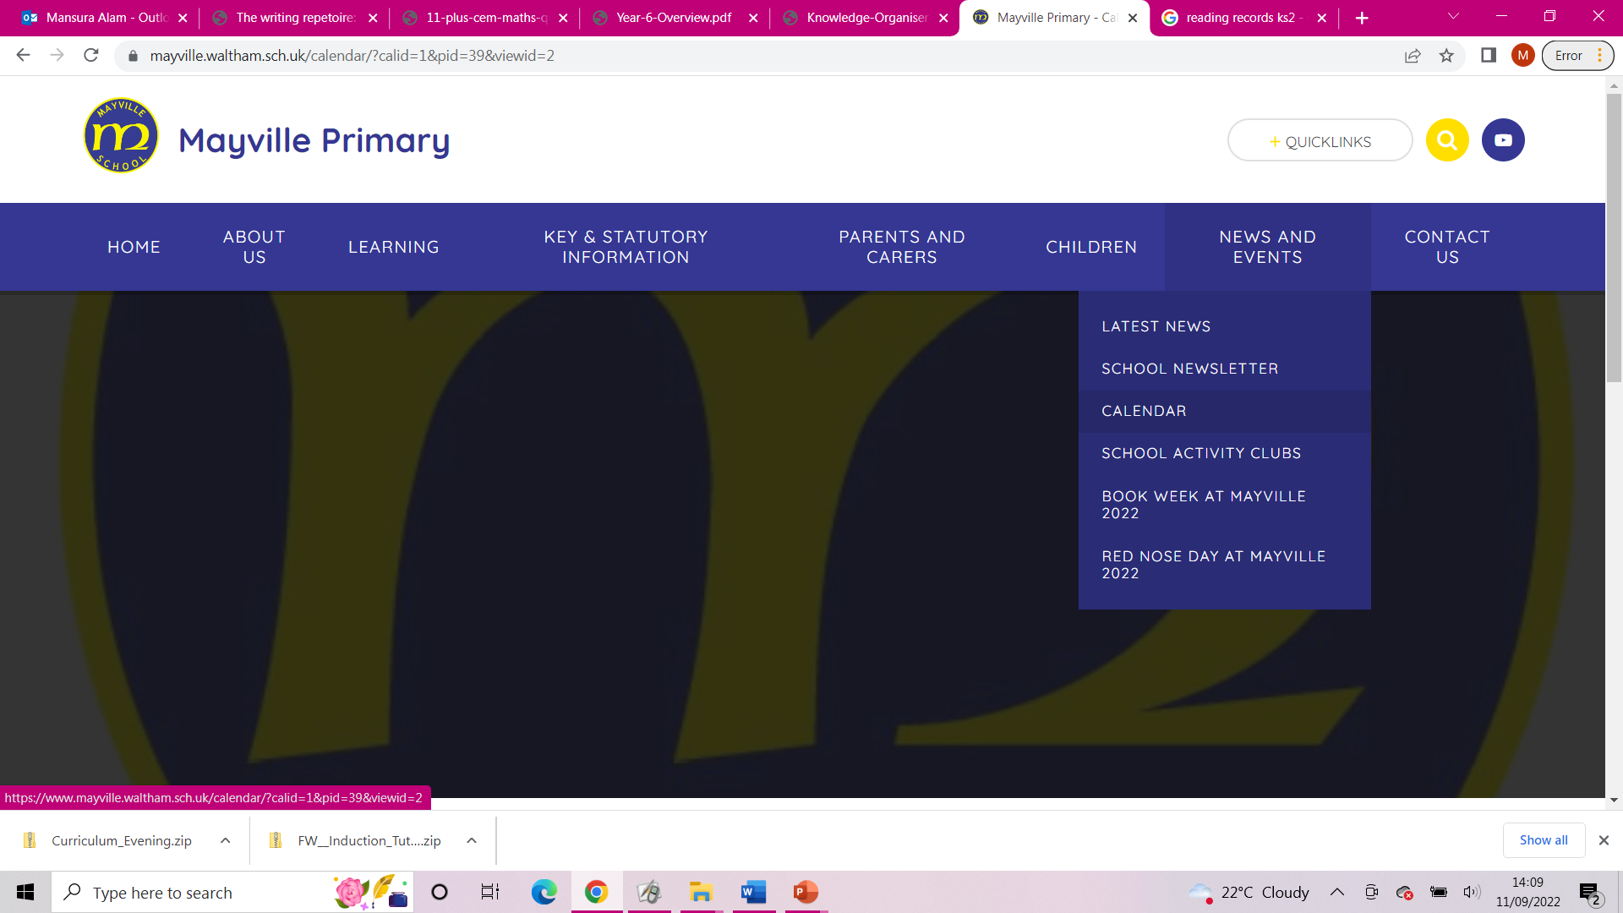
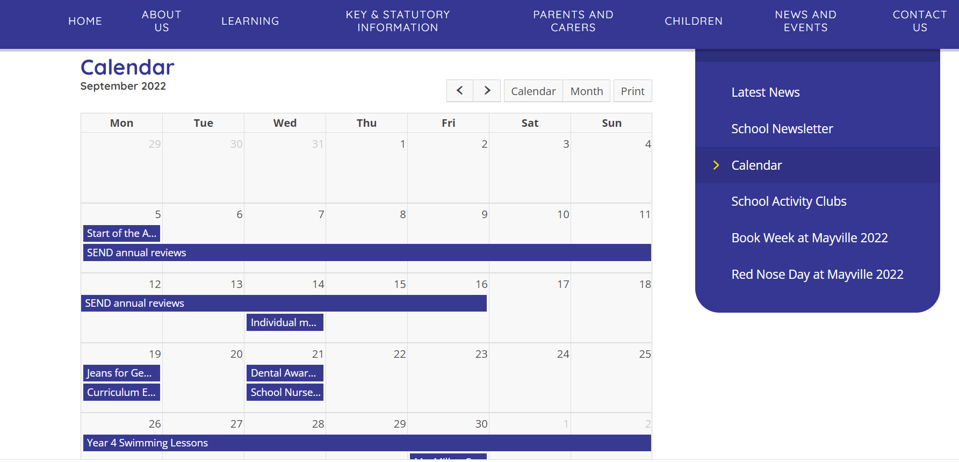
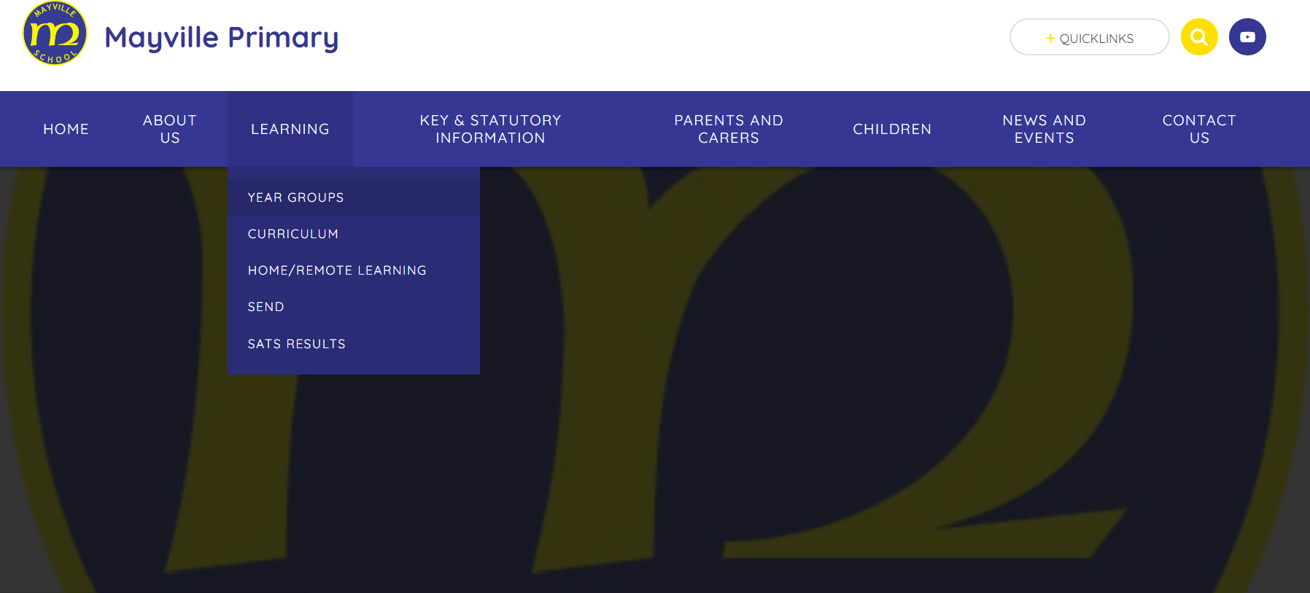
School Website

Slide 24


Any Questions
Thank you for coming – together we can make a difference, and provide all the children in Year 5 with the best possible experience during their final year at Mayville.

